Slide 1


Working together to achieve success in remediation Jason Weir, Catherine Davidson, Nadia Ali
ILANZ Conference July 2023

Slide 2
Open the conference app
Go to Programme
Tap on Session 4A
Click Live Q&A

Slide 3
Who has experience working on a remediation project?

Slide 4
What is your level of confidence in knowing the steps to take for a successful remediation?

Slide 5
What may create the need for a remediation programme?
Overcharging customers
Underpaying
employees / vendors
Data / privacy breaches
Regulatory non-compliance
Process
Data
Architecture
Customer / Employee

Slide 6
Remediation lifecycle
Governance & Project Management
Problem Validation
Scope & Contain
Impact Analysis
Remediation
Prevention
Ensure the problem is well understood and validated before launching remediation exercise
Scope project, identify & protect relevant data and enable short term remedial action
Undertake analysis to understand the extent of the impact and cause
Design remediation methodology and action the plan
Future proof to address systematic issues

Slide 7
Governance & Project Management
How are decisions made?
Is there a robust financial management and provision framework?
How are risks managed and confidence provided through the life of remediation?
How is information cascaded?
How are activities efficiently & effectively choregraphed (internally and with external stakeholders)?
Drivers
Achieve a “one time” remediation
Transfer lessons learned to business as usual operations
Creating traceability
Demonstrate good governance disciplines

Slide 8

Problem Validation
Ensure the problem is well understood and validated before launching remediation exercise
Confirming what you know
Confirming what
you don’t know

Slide 9

Scope & Contain
Scope project, identify & protect relevant data and enable short term remedial action
What is the appropriate scope and level of response?
Which systems hold relevant data?
How do we ensure it is retained & accessible?
What are our legal obligations & protocols?
Is there a need to advise a regulator?
What steps need to be taken to mitigate the issue ahead of remediation?
What is the make up of the team that needs to be mobilised?

Slide 10
Scope & Contain | Typical team construct
A collaborative team of in-house and external specialists across a breadth of competencies
External Lawyers
In-house Legal
Executive Sponsor
Governance Board
Remediation Project Lead
Project Management
Product / Process SMEs
Technical SMEs
Other SMEs
Project and Programme Management disciplines
May include Agile specialists
Process Owners
Product Owners
Model Owners
Customer Experience
Information Technology
Systems Architects
Data Analysts
Data Scientists
Digital Forensic/Discovery
Cyber Specialists
Forensic Accountants
Case / Claims Management
Regulatory Specialists
Risk/internal audit
Privacy
External communications

Slide 11



Impact Analysis
Undertake analysis to understand the extent of the impact and cause
Articulating the problem statement
Identifying the impacted Population
High level estimate of scale & liability
Typical skills required
Cleanse, analyse & visualise large and complex data sets
(e.g. SQL, Python, Tableau, Relativity)
Process & system architecture mapping and analysis
Leveraging technology as an accelerator
(incl. AI & ML)
Legal and compliance
Forensic accounting
Support to regulator engagement

Slide 12
Which clients had loss making contracts and what termination clauses applied?
CRM System
Financial System
Contracts
Relational database
Coding / AI /
Machine Learning
Visualisation & reporting

Slide 13




Automated contract review
AI can accelerate the initial identification of documents and extraction of key terms.
Challenges
1
2
Multiple contract repositories spread across the organisation
Collection: Identify and access relevant sources where contracts may be located
Document level: Further refine in-scope documents through targeted keyword searches
3
4
Variety of formats – typically a high proportion of scanned documents
Clause A
Clause B
Contract
Non-contract
Wording for similar clauses can vary considerably from contract to contract
Document level: Auto-classify document types to fast track contract identification
Within the document: Identify and extract key contractual clauses

Slide 14
Remediation
Design remediation methodology and action the plan
Clear timeframe and means of executing
(Project Management)
Explainable and defendable methodology
Choreographing to make most from investment
Process
Data
Architecture
Customer / Employee

Slide 15
Remediation | Refunding customers/employees
Context and requirements
Volume
Brand
Context
Identify
Verify
Communicate
Workflow
Report
Audit
Requirements
User experience
Digital solution
Governance
Ingredients for success

Slide 16
Remediation | Refunding customers / employees
Workflow and digital solution
Website
Digital solution
Submission
Triage
Assessment
Resolution
Customer / Employee
Digital
Phone
Telephony solution
Assessment team
In person
Comms and documents
Reporting/dashboards
Audit history
Management and Governance

Slide 17
Remediation lifecycle | Prevention
Future proof to address systematic issues
Testing automation
By design
Show me don’t tell me
Assurance
Change with Capital C
Business environment
Governance
Operating model
System, People, Processes
Controls

Slide 18
Summary
How would you respond to your next remediation?
Large, complex, long run projects
Right people
Right technology

Slide 19
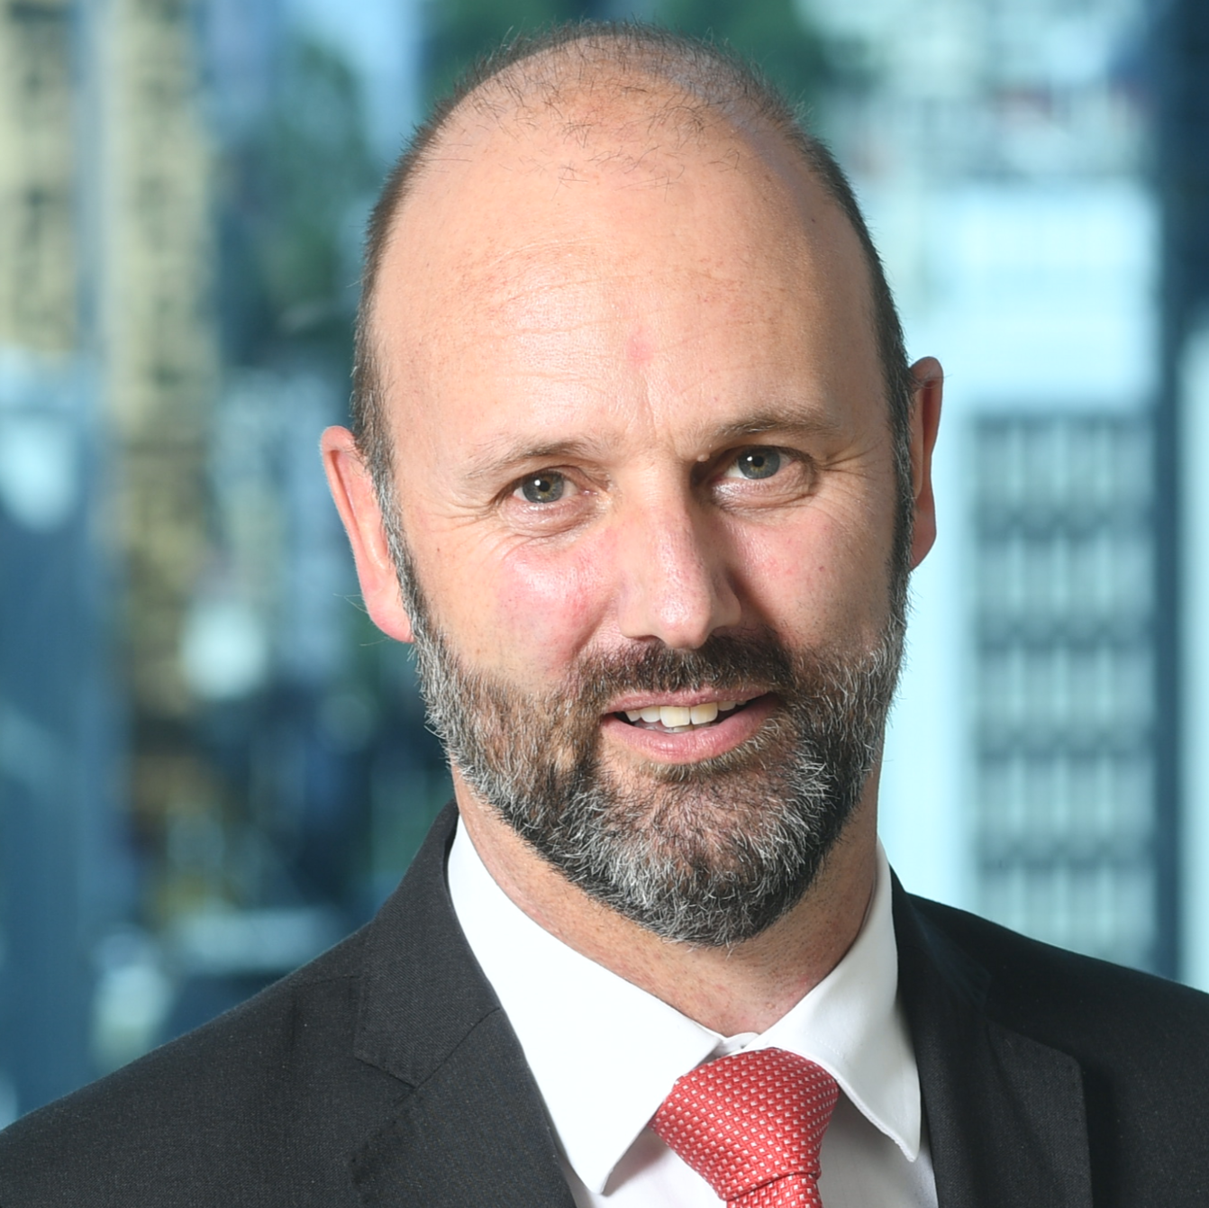
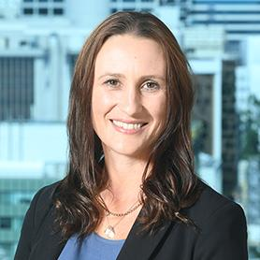
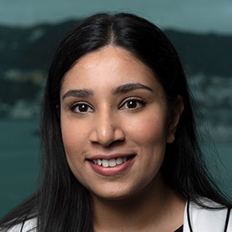
Questions?
Jason Weir
Partner, Auckland
DDI: +64 9 303 0966
Mobile: +64 21 535 705
Email: jasweir@deloitte.co.nz
Catherine Davidson
Director, Auckland
DDI: +64 9 952 4205
Mobile: +64 21 241 5488
Email: catdavidson@deloitte.co.nz
Nadia Ali
Director, Wellington
DDI: +64 4 470 3650
Mobile: +64 22 457 3115
Email: nadiaali@deloitte.co.nz

