Slide 1


Making ADR work for you – A Guide for In-house Counsel
Presented by Nicole Smith and Malcolm Wallace

Slide 2
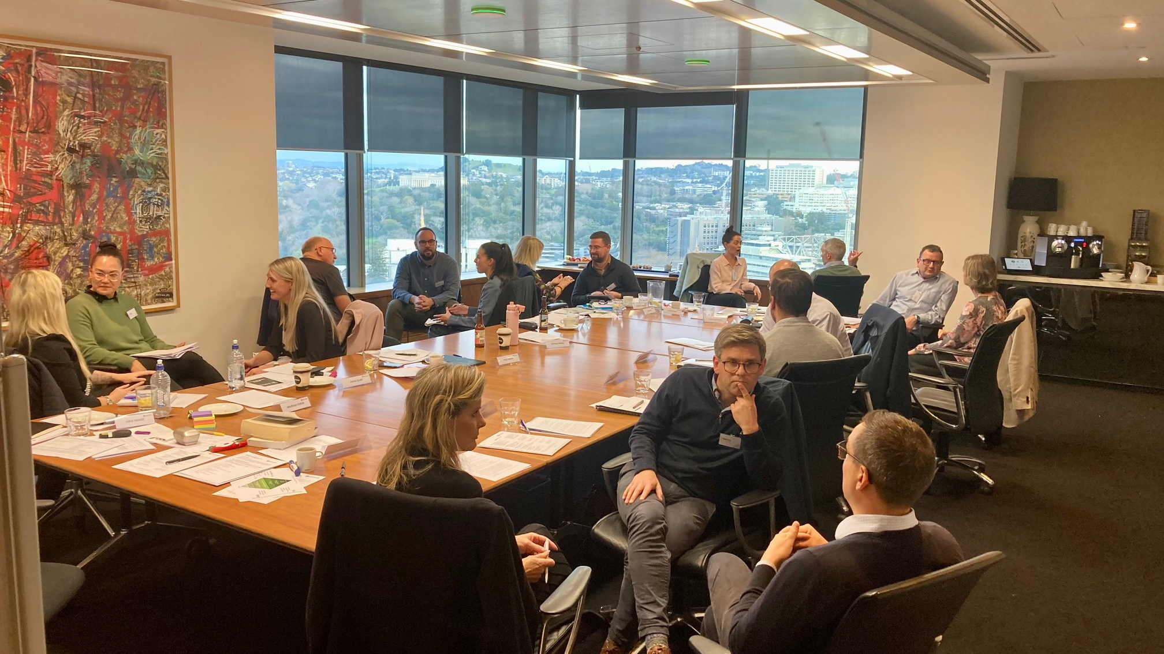
AMINZ
New Zealand’s lead organisation for dispute resolution professionals

Slide 3

Dispute resolution options: From peace pipes to freezing injunctions
  Negotiation
  Mediation
  Expert Determination
  Adjudication
  Arbitration
  Court

Slide 4


Confidentiality
The benefits and advantages of adopting an ADR process
Speed
Preserving
relationships
Cost
Quality

Slide 5

Lifting the lid –
how to get the most out of an Arbitration
  Appointment
  Planning
  Documents
  Pleadings
  Hearings

Slide 6

Key aspects of mediation success
  Preparation
  Personnel
  Attitude
  Authority to settle
  Documenting settlement

Slide 7
Should you draft your own dispute resolution clause?

Slide 8

Industry Templates
Model Dispute Resolution Clauses (including reference to mediation):
  ADLS/REINZ
  ADLS Commercial Lease

Slide 9

Clauses
Model Arbitration Clauses:
www.aminz.org – Arbitration clause for arbitrations under the AMINZ Rules:
The parties agree that any dispute or disagreement arising out of or in connection with this agreement will be settled by arbitration by [a sole arbitrator] in accordance with the AMINZ Arbitration Rules current at the time the arbitration is commenced. The place of arbitration will be [Auckland] and the law applicable to any issues in relation to the agreement to arbitrate, the arbitral proceedings [and the matters in dispute] will be [New Zealand law]
Ad hoc clause for arbitrations under the Arbitration Act 1996:
The parties agree that any dispute or disagreement arising out of or in connection with this agreement will be settled by arbitration by [a sole arbitrator]. The place of arbitration will be [Auckland] and the law applicable to any issues in relation to the agreement to arbitrate, the arbitral proceedings [and the matters in dispute] will be [New Zealand law].

Slide 10
Contact
Nicole Smith
Email: nicole@nicolesmith.co.nz
Mobile: 021 175 9014
Website: www.nicolesmith.co.nz
Malcolm Wallace
Email: wallace@freedomchambers.co.nz
Mobile: 027 260 3431
Website: www.malcolmwallace.co.nz
www.aminz.org.nz

